Slide 1
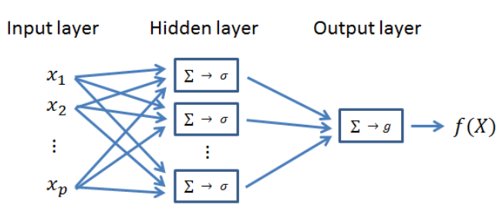
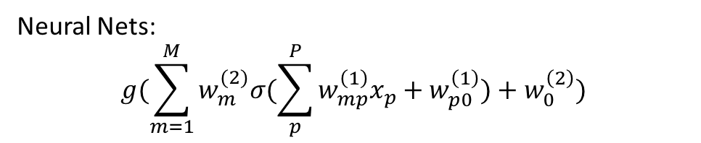
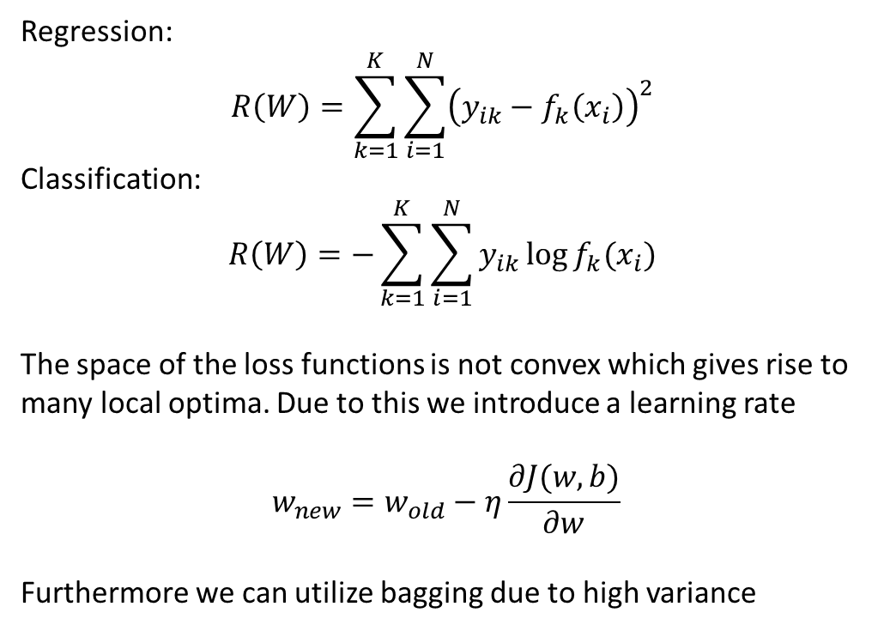
Lecture 11
Neural Nets:
$$g(\sum_{m=1}^{M}{w_{m}^{(2)}σ(\sum_{p}^{P}{w_{mp}^{\left(1\right)}x_{p}+w_{p0}^{\left(1\right)})+w_{0}^{\left(2\right)})}}$$
Regression:
$$R\left(W\right)=\sum_{k=1}^{K}{\sum_{i=1}^{N}{{\left(y_{ik}−f_{k}\left(x_{i}\right)\right)}^{2}} }$$
Classification:
$$R\left(W\right)=−\sum_{k=1}^{K}{\sum_{i=1}^{N}{y_{ik}\log{f_{k}(x_{i})}} }$$
The space of the loss functions is not convex which gives rise to many local optima. Due to this we introduce a learning rate
$$w_{new}=w_{old}−η\frac{∂J(w,b)}{∂w}$$
Furthermore we can utilize bagging due to high variance
Linear or non linear activation function
g is almost always linear.
Can be thought of as an affine combination of non linear functions. -> one layer can describe everything on a compact set.
Notes:
Gini er konventionen til opbyggelse og miss class er til prune

Slide 2
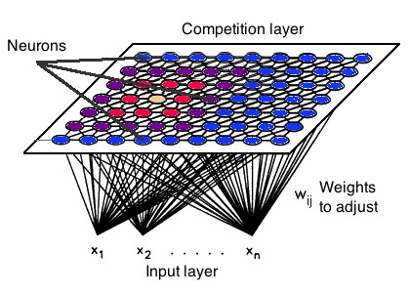
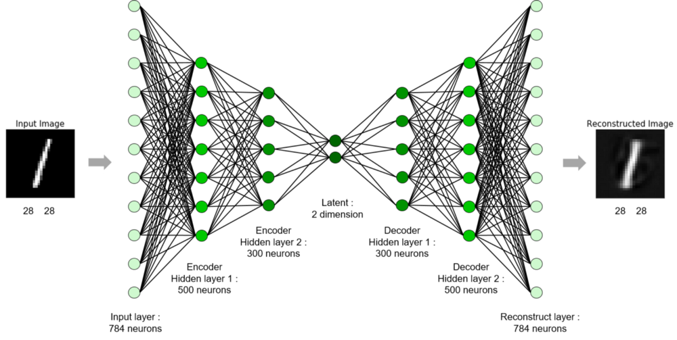
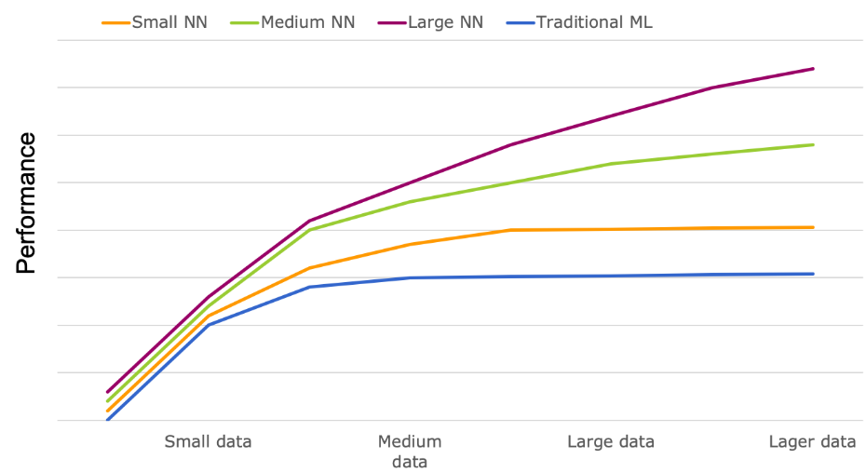
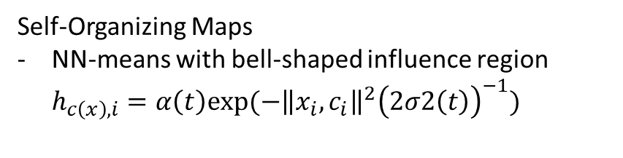
Lecture 11
High variance models are prone to over fit. We therefore introduce different means to overcome this
Early stopping
Regularization
Data augmentation(sampling techniques)
Unsupervised:
Autoencoders
Self-Organizing Maps
NN-means with bell-shaped influence region $h_{c\left(x\right),i}=α\left(t\right)exp⁡(−{\left\|x_{i},c_{i}\right\|}^{2}{\left(2σ2\left(t\right)\right)}^{−1})$
Deep Learning
All in one model
If linear activation PCA except orthonormality
Notes:
Gini er konventionen til opbyggelse og miss class er til prune

